Slide 1
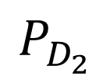
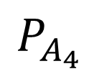
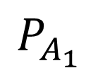
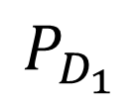
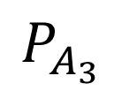
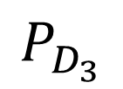
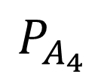
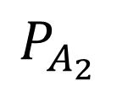
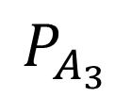
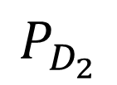
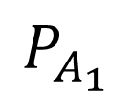
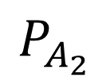
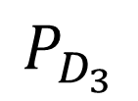
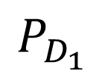
$$P_{A_{1}}$$
$$P_{A_{1}}$$
$$P_{D_{1}}$$
$$P_{D_{1}}$$
Maximum matching
$$P_{A_{2}}$$
$$P_{A_{2}}$$
$$P_{D_{2}}$$
$$P_{D_{2}}$$
$$P_{A_{3}}$$
$$P_{A_{3}}$$
Pair-wise outcomes
$$P_{D_{3}}$$
$$P_{D_{3}}$$
$$P_{A_{4}}$$
$$P_{A_{4}}$$

